Slide 1
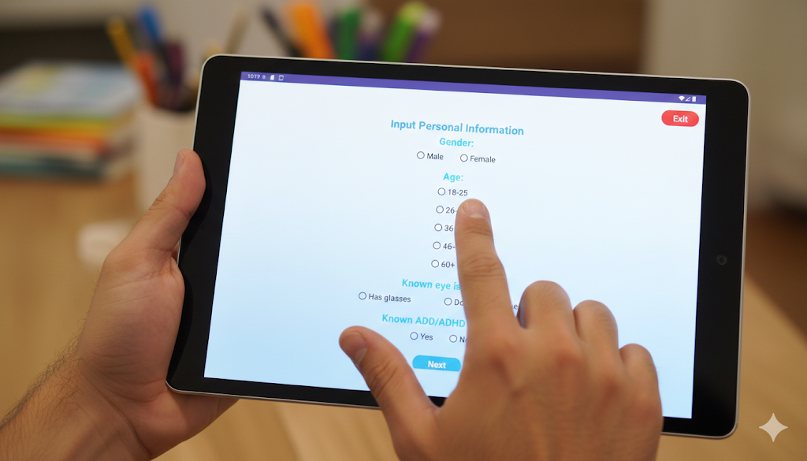

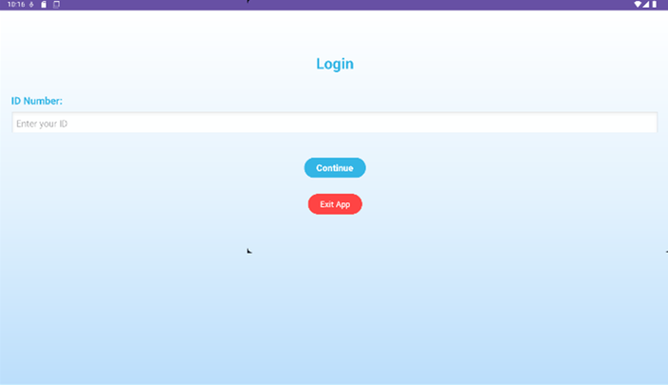
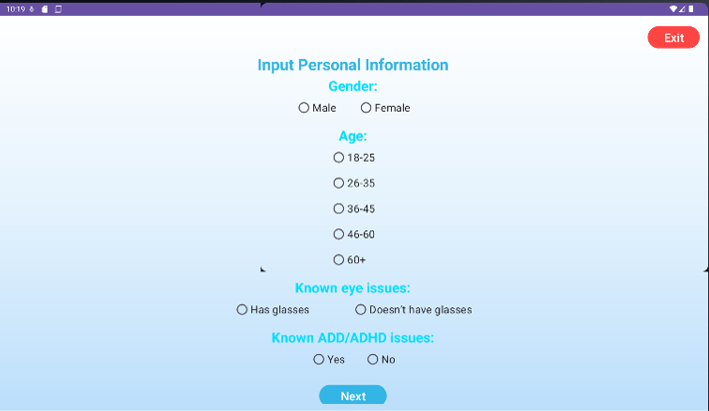
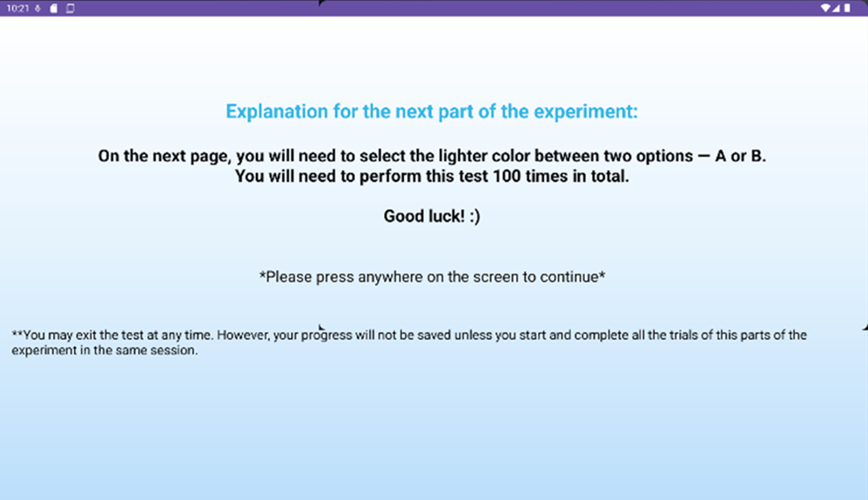

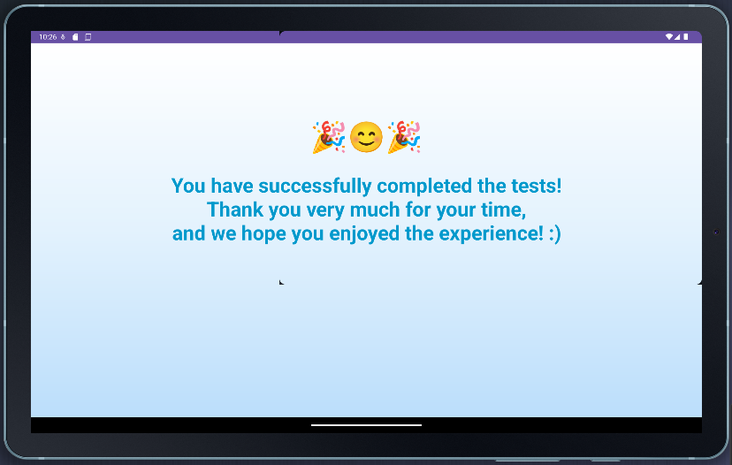
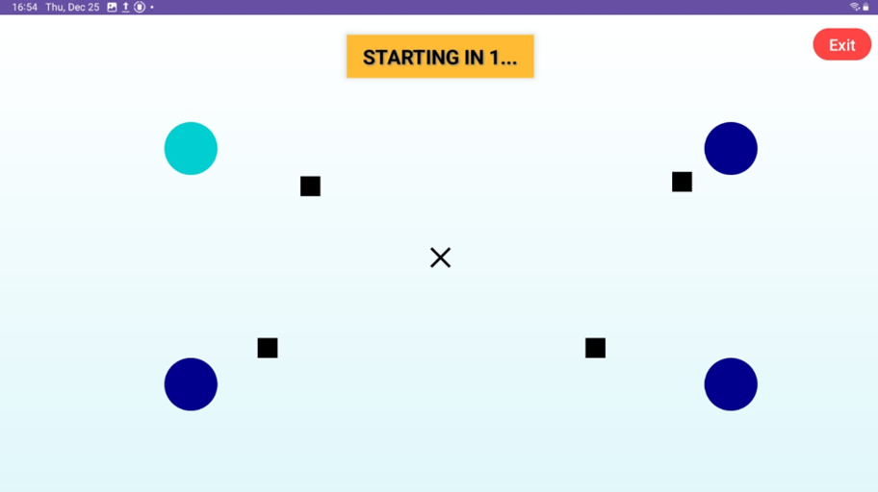
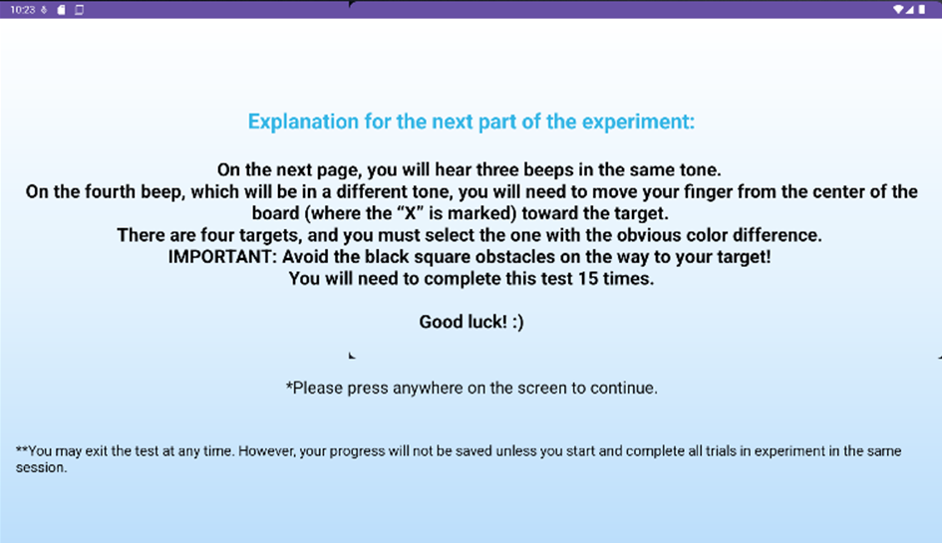
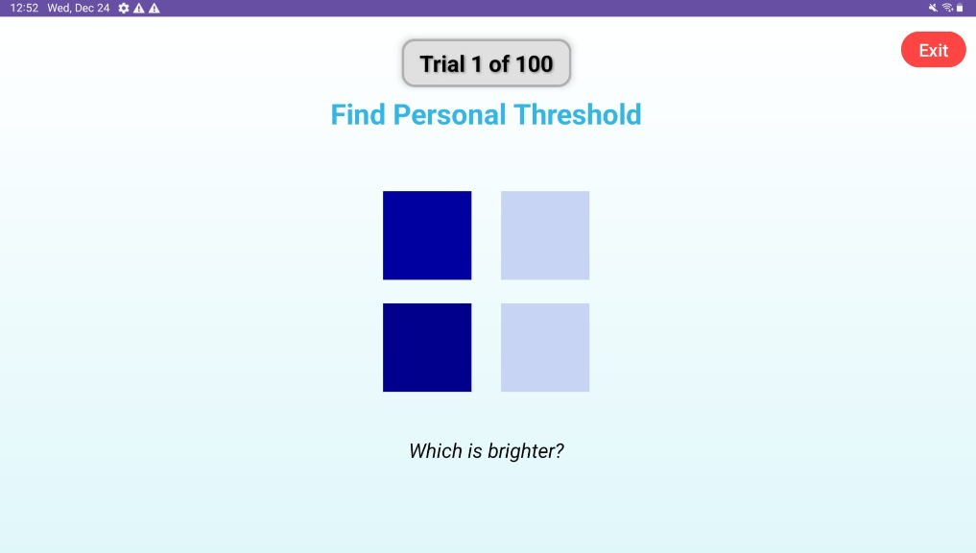
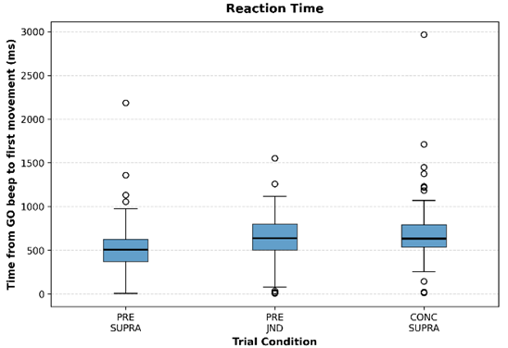
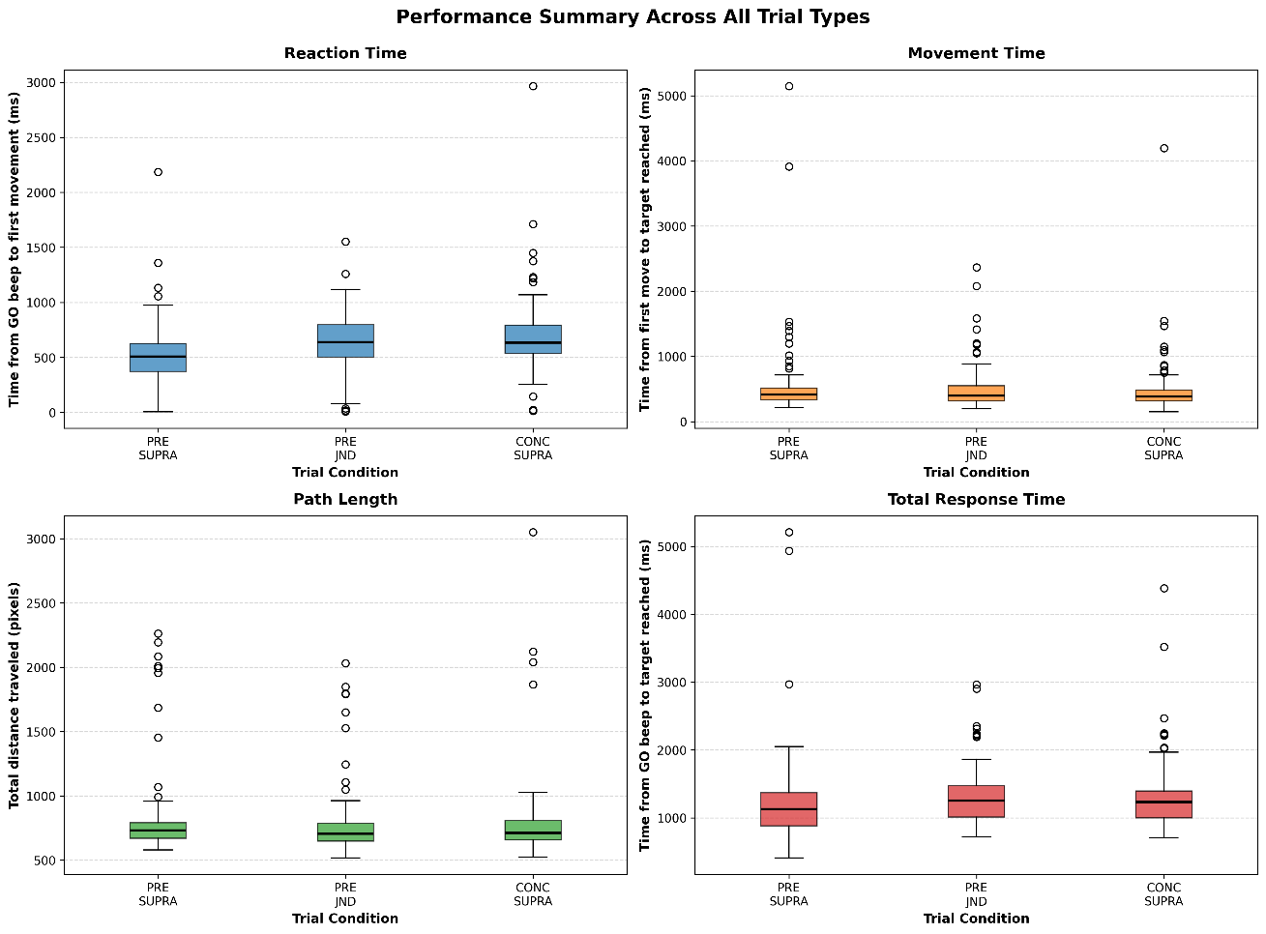




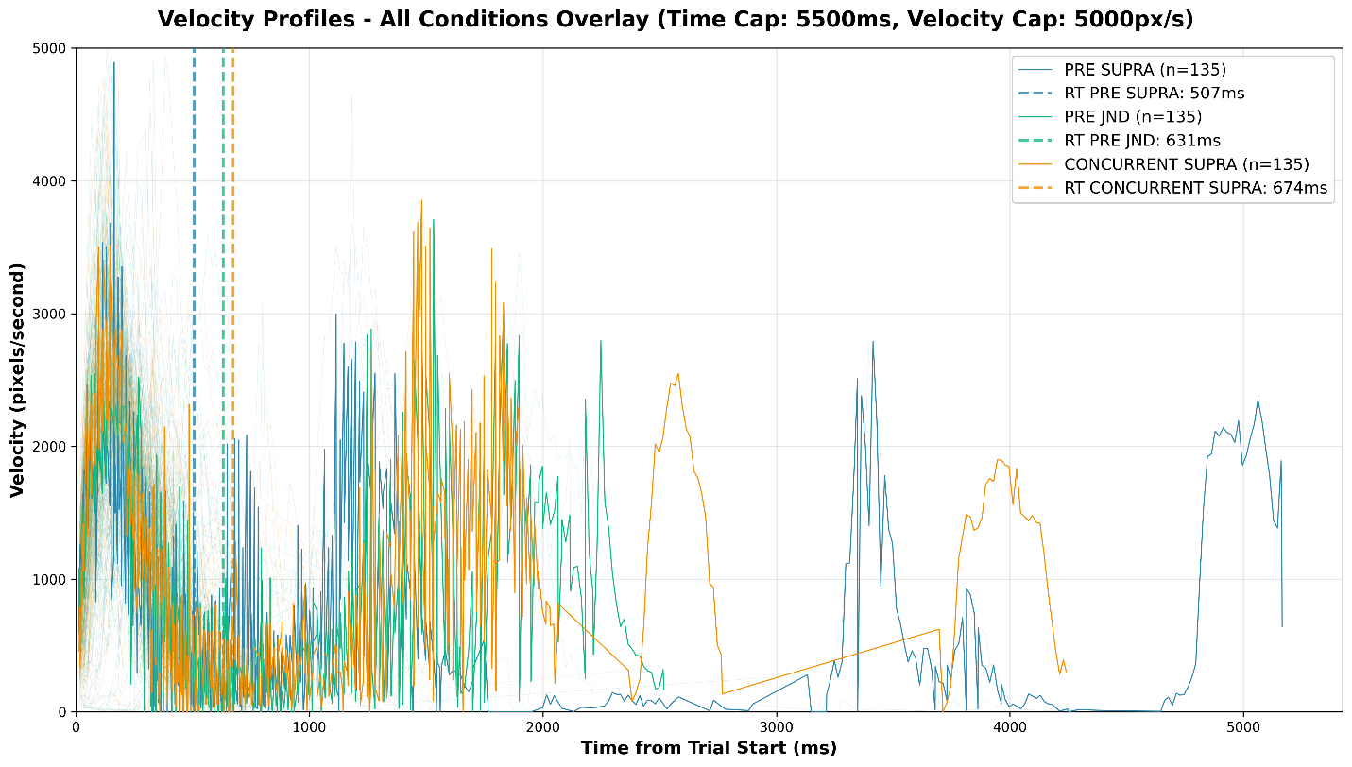

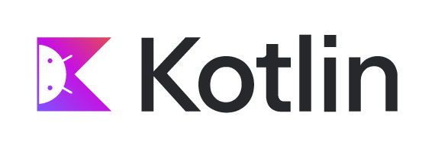











Impact of subliminal perception on motor planning
A platform that examines how subliminal and conscious visual cues influence goal-directed reaching movements
Software Engineering Department • Braude College of Engineering
Daniel Shahar & Rachel Avidan-King • January 2026
| The Data Gathering Application
| Research Applications
🧠
🤝
Motor Neuroscience Examine how subliminal and suprathreshold visual cues affect motor planning and reaction time
🤝
Login Screen- ID number
Registration Process (New Participants)
Explanation Screen
💬
Perception–Action Research Study the relationship between perceptual awareness (JND) and goal-directed movement
🧩
🏥
Individualized Perception Studies Support personalized experiments based on individual perceptual thresholds
📈
Experimental Trials
Explanation Screen
🎓
Cognitive & Clinical Applications Explore motor behavior differences across cognitive and demographic groups
Experiment Completion
Performing the JND Task
📊
Scalable Behavioral Data Analysis Support large-scale data collection with automated analysis and visualization
| Project Objectives
| Research Results
🧩
Comparison Across Experimental Conditions
Develop a mobile app guiding participants through registration, threshold calibration, and reaching trials
| System Architecture
📈
Implement a personalized JND-based thresholding mechanism
Android-based Experimental Application
Responsible for participant interaction, experiment execution, and initial data collection
Enable precise control of timing and trial conditions for consistent cue presentation
Time from GO signal to movement onset
Time from movement onset to target acquisition
Path length, derived from recorded (x, y) coordinates, reflecting movement directness and control
Movement Metrics and Trajectory Analysis
Previous research has show that trials with a clear hint (pre-supra) would have the better metrics (the fastest reaction time, the more bell like velocity curves, etc.) compared to no hint (concurrent-supra). The hypothesis was that a subliminal hint (pre-JND) would also have better results than no hint at all, but not as good as a clear hint. The graphs support this hypothesis.
Cloud-Based Data Storage
Used for centralized, secure storage of completed experimental data
Ensure management, secure, reliable data storage and synchronization
Velocity profiles of all current participant trials. Different colors express the different trial conditions.
🌍
Design a modular, maintainable architecture for easy extension and reuse
Python-Based Data Analysis Pipeline
Used for data extraction, cleaning, analysis, and visualization following data collection
✅
Develop a pipeline for post-processing and visualizing behavioral metrics
| Key Features
The Android app collects data locally and syncs it to the cloud for separate analysis
| Technical Implementation
Participant Identification and Access Control
Participant Registration and Data Collection
Programming
Development Environment
Personalized Perceptual Threshold Determination
Guided Experimental Workflow
Reaching Movement Experiment Execution
Accurate Data Capture
| Conclusions & Future Work
📱
Expanded Participant Pool
Build System
Tools
Local Data Persistence
Cloud-Based Data Synchronization
⚡
Cross-Device Validation
🧠
Real-Time Data Monitoring
Fault-Tolerant Data Upload
Data Analysis and Visualization Support
Extended Experimental Paradigms
Improved Automation and Reporting
Contact: Daniel.Shahar@e.braude.ac.il AND Rachel.Avidan.King@e.braude.ac.il Project Repository: https://github.com/RachelAvidanKing/Capstone-Project-App
Acknowledgments: Special thanks to Dr. Anat Dahan and Dr. Marcos Hilsenrat

